Slide 1


Thermal Modeling of a 2U Cube Satellite-PSAS Approved
Abacus style calculations by Kyle Blakeman
Morale Beatings by Andrew Greenberg
Faculty Supervision by Dr. Erik Bodegom
Notes:
Official PSAS Intro Slides
Last modified 2015/04/07 -- Updated with slides from NARCON 2015, added updated GPS, removed some cruft.

Slide 2
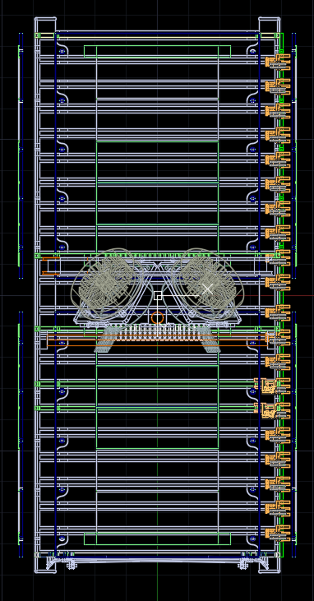
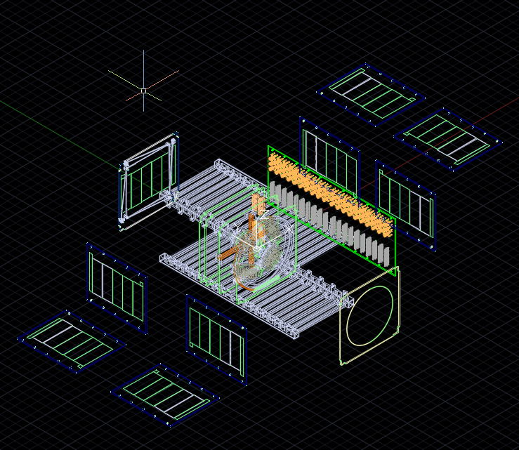
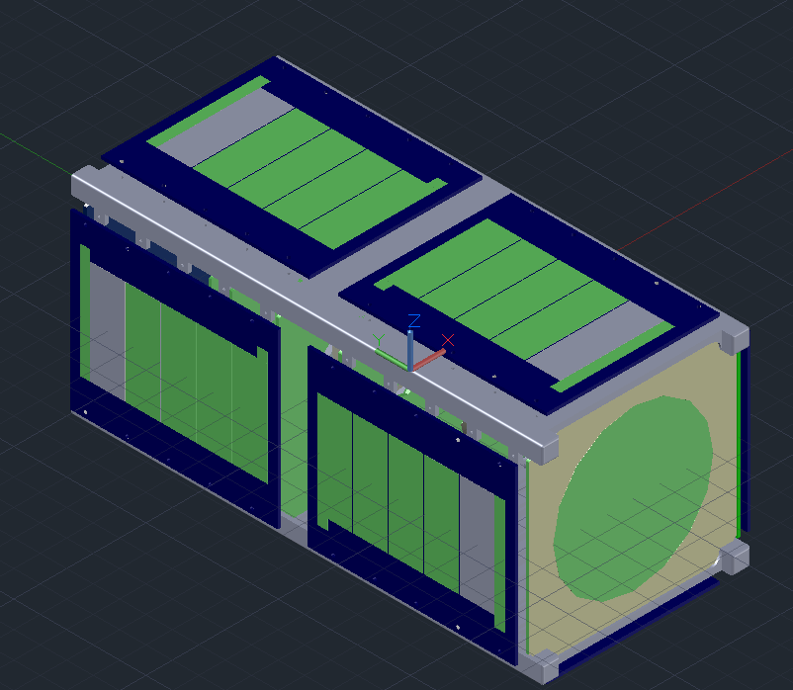
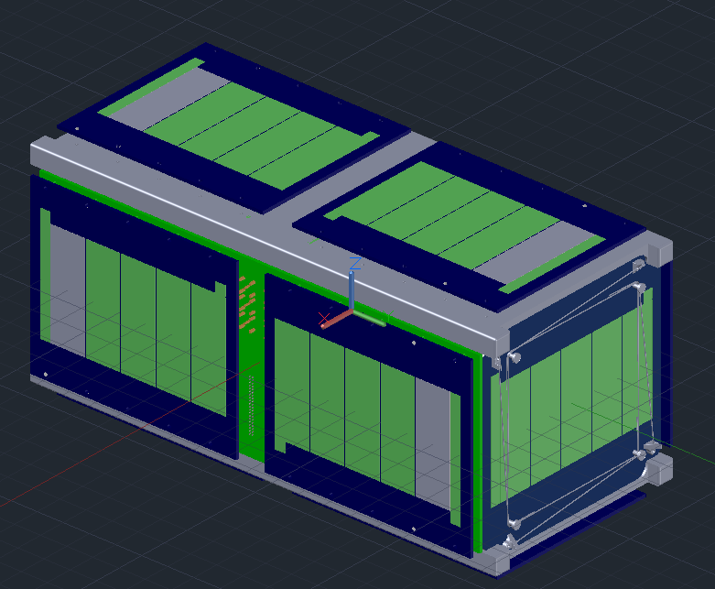
The CubeSat aka Sputnik

Slide 3
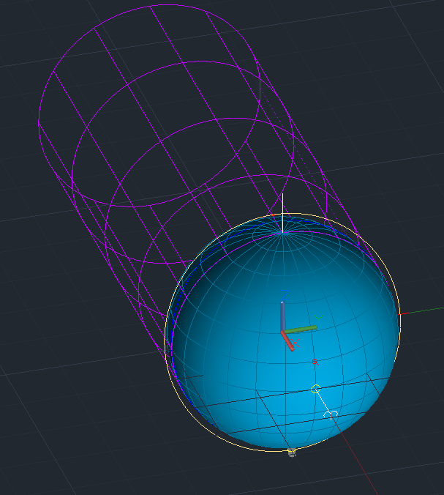
Thermal Exchange
Thermal radiation in orbit comes from direct solar insolation, albedo radiation and Earth's blackbody radiation.
Exports take the form of radiation and conduction throughout the satellite.
Convection cannot occur due to lack of transfer medium i.e. air

Slide 4
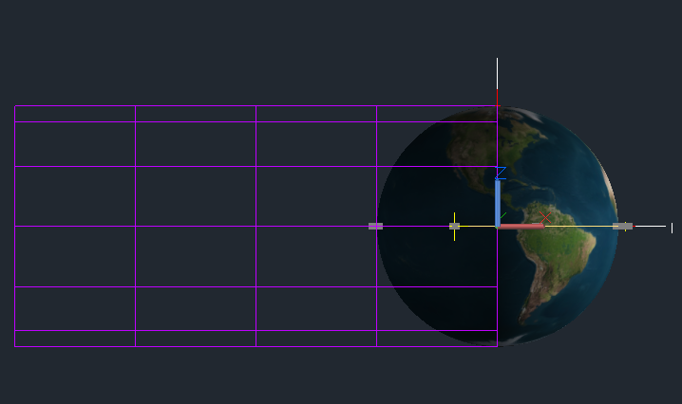
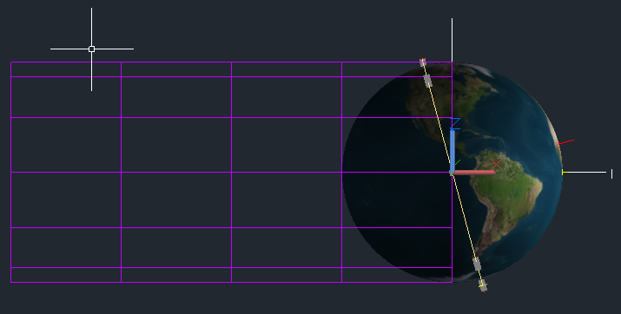
Simulating Space
Beta angle dictates the hot vs cold case
The max beta angle for the ISS is 75º (hot) and the min is 0º (cold)
Mission objective requires the main helical antenna to point at Earth.
Variations in orientation provide insight into how orbital behavior affects temperature

Slide 5
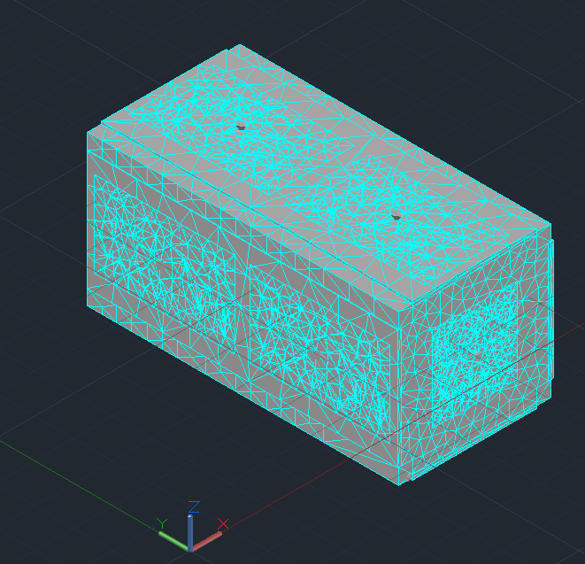
Thermal Desktop
Created by C&R Technologies
AutoCAD plug-in
Creates a finite element mesh of nodes over the surface of the model
Allows user to manipulate heating environment, material properties, and modeling tools

Slide 6
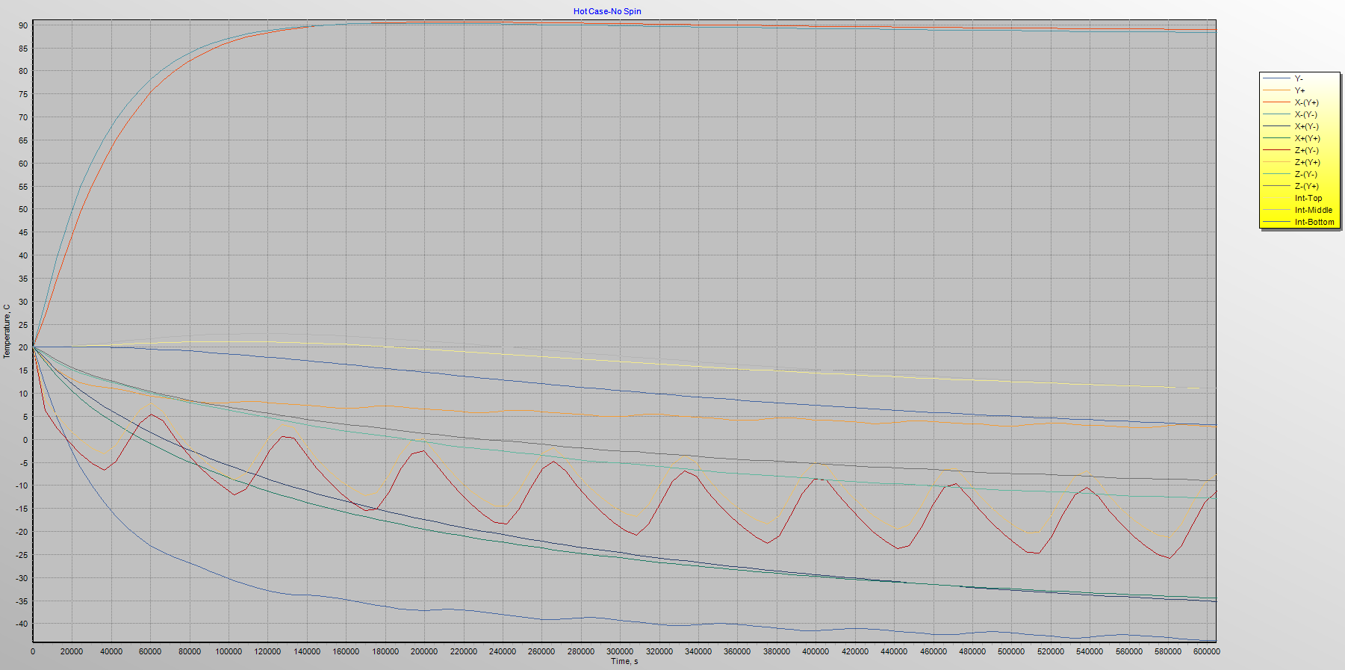

Slide 7
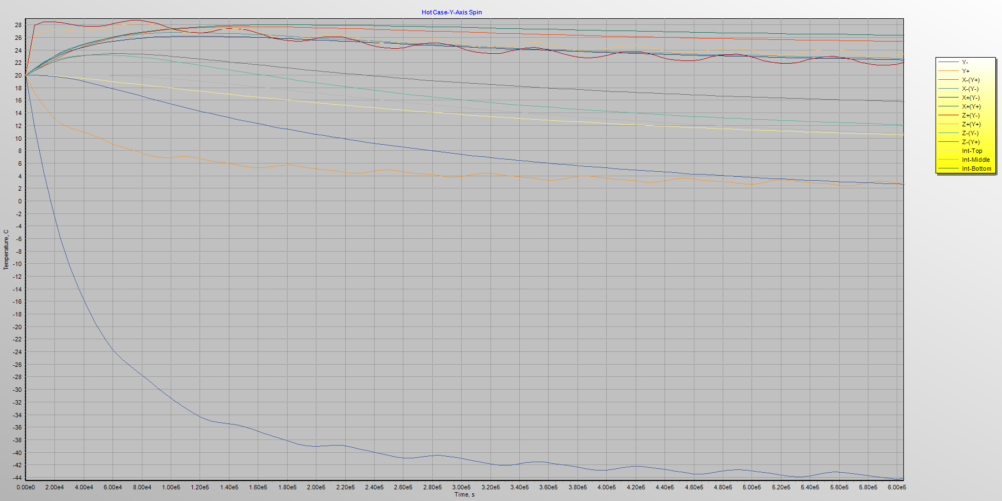

Slide 8
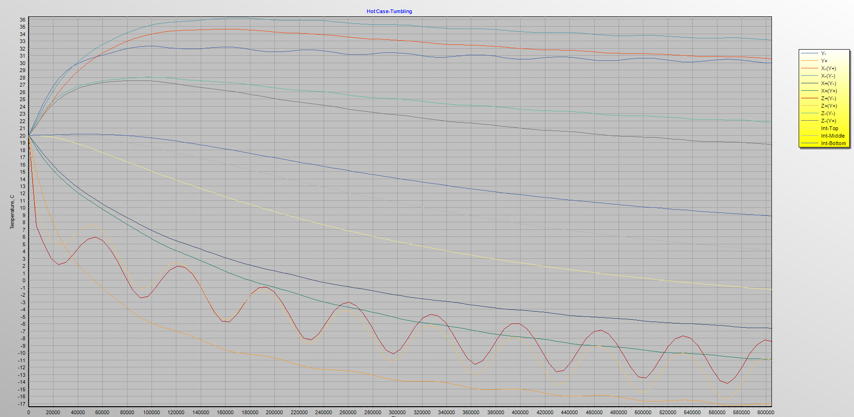

Slide 9
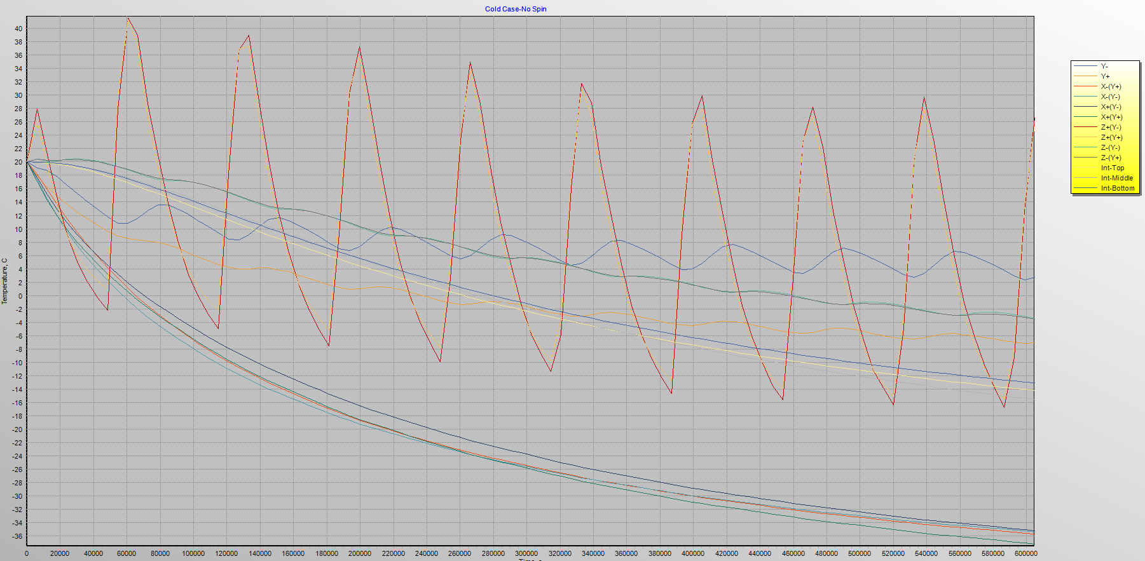

Slide 10
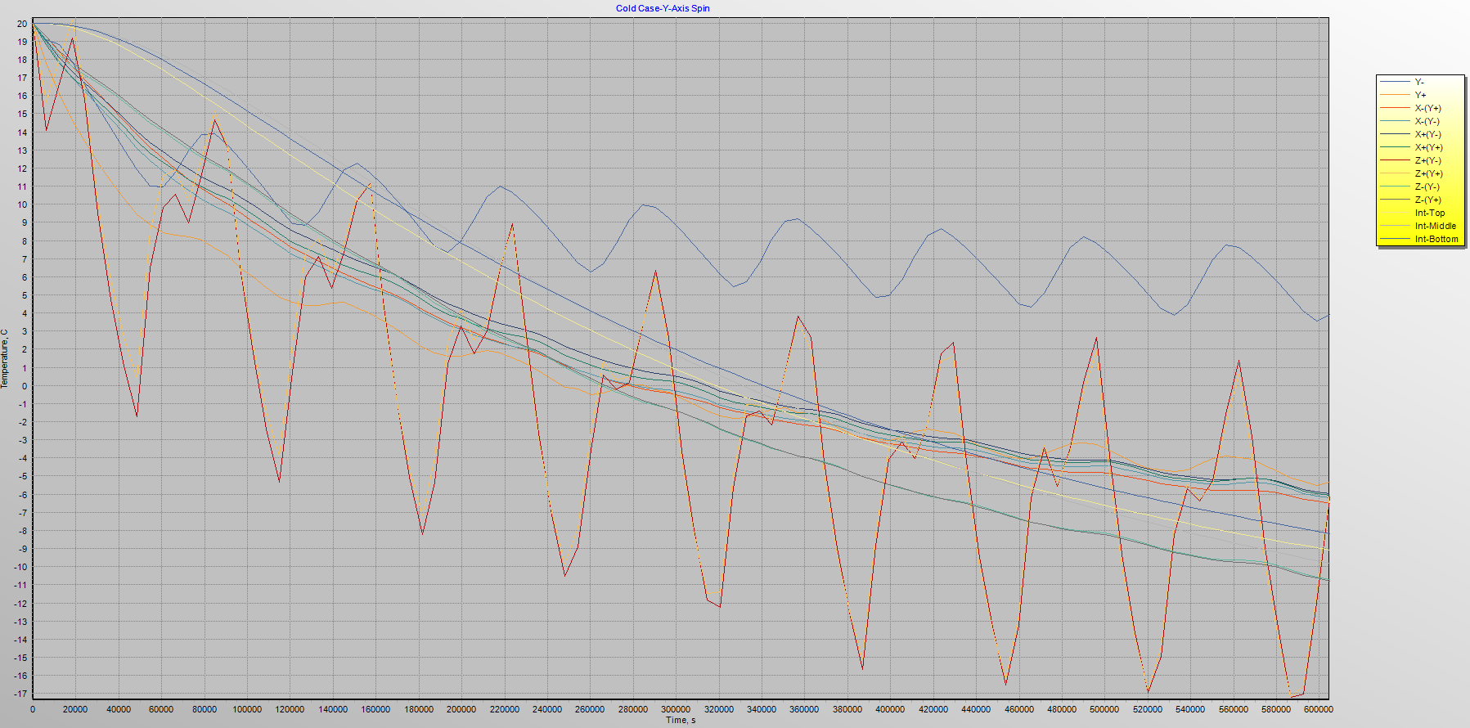

Slide 11
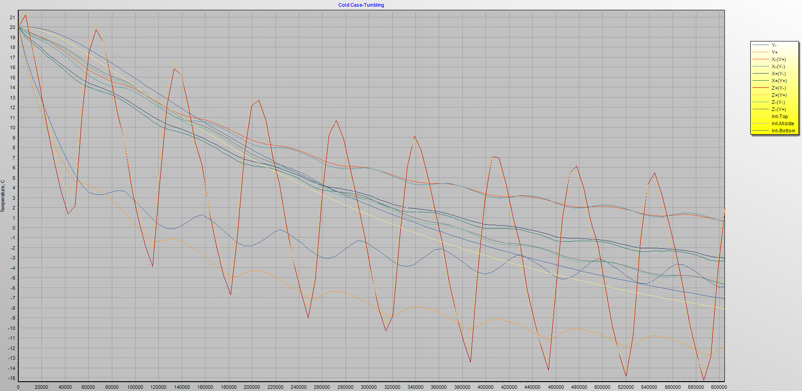

Slide 12
Hot Case | No Spin |  | Tumbling |  | Y-Axis Spin
Name | Min Value | Max Value | Min Value | Max Value | Min Value | Max Value
Y- | -43.66 | 20.00 | 20.00 | 32.30 | -44.27 | 20.00
Y+ | 2.47 | 20.00 | -17.27 | 20.00 | 2.41 | 20.00
X-(Y+) | 20.00 | 90.60 | 20.00 | 34.65 | 20.00 | 27.71
X-(Y-) | 20.00 | 90.32 | 20.00 | 36.17 | 20.00 | 26.79
X+(Y-) | -35.19 | 20.00 | -6.61 | 20.00 | 20.00 | 26.18
X+(Y+) | -34.45 | 20.00 | -10.88 | 20.00 | 20.00 | 28.03
Z+(Y-) | -25.86 | 20.00 | -14.22 | 20.00 | 20.00 | 28.74
Z+(Y+) | -21.35 | 20.00 | -16.37 | 20.00 | 20.00 | 28.20
Z-(Y-) | -12.89 | 20.00 | 20.00 | 28.02 | 12.10 | 23.23
Z-(Y+) | -9.00 | 20.00 | 18.70 | 27.53 | 15.81 | 23.41
Internal-Top | 11.07 | 21.24 | -1.28 | 20.00 | 10.51 | 20.00
Internal-Middle | 11.11 | 22.96 | 4.10 | 20.00 | 10.71 | 20.03
Internal-Bottom | 3.16 | 20.07 | 8.87 | 20.16 | 2.65 | 20.00

Slide 13
Cold Case | No Spin |  | Tumbling |  | Y-Axis Spin
Name | Min Value | Max Value | Min Value | Max Value | Min Value | Max Value
Y- | 2.39 | 20.00 | -5.90 | 20.00 | 3.55 | 20.00
Y+ | -7.16 | 20.00 | -12.73 | 20.00 | -5.51 | 20.00
X-(Y+) | -35.71 | 20.00 | 0.59 | 20.00 | -6.49 | 20.00
X-(Y-) | -35.39 | 20.00 | 0.55 | 20.00 | -6.18 | 20.00
X+(Y-) | -35.22 | 20.00 | -3.01 | 20.00 | -5.97 | 20.00
X+(Y+) | -37.23 | 20.00 | -3.35 | 20.00 | -6.07 | 20.00
Z+(Y-) | -16.74 | 41.54 | -15.25 | 21.21 | -17.19 | 20.00
Z+(Y+) | -15.62 | 41.31 | -14.90 | 21.56 | -17.21 | 20.17
Z-(Y-) | -3.44 | 20.47 | -5.78 | 20.00 | -10.72 | 20.00
Z-(Y+) | -3.55 | 20.39 | -5.66 | 20.00 | -10.78 | 20.00
Internal-Top | -14.19 | 20.00 | -8.09 | 20.00 | -9.09 | 20.00
Internal-Middle | -15.57 | 20.00 | -6.86 | 20.00 | -9.82 | 20.00
Internal-Bottom | -13.11 | 20.00 | -7.10 | 20.00 | -8.17 | 20.00

Slide 14
Conclusions
No Spin scenario causes large extrema
Tumbling is not ideal from a communications standpoint but at least nothing will melt
Y-Axis spin offers best solution but creates other problems
 | No Spin |  | Tumbling |  | Y-Axis Spin
Beta Angle | Min Value (°C) | Max Value (°C) | Min Value (°C) | Max Value (°C) | Min Value (°C) | Max Value (°C)
75 | -43.66 | 90.60 | -17.27 | 36.17 | -44.27 | 28.74
0 | -37.23 | 41.54 | -15.25 | 21.56 | -17.21 | 20.17

Slide 15
Special Thanks Too…
Aaron Baker
Austin Joseph
Jeremy Louke
The OreSat crew
C&R Technologies

Slide 16
Thank you
Questions?

